Slide 1
GDP Assignment
Submitted by: Janarthanan Balasubramanian
(jnvdasa@gmail.com)

Slide 2
Project Brief
The CEO of NITI Aayog has initiated a project to provide top-level recommendations to the Chief Ministers (CMs) of various states of India, to help them prioritize areas of development for their respective states. Since different states are in different phases of development, the recommendations should be specific to the states. The overall goal of this project is to help the CMs focus on areas that will foster economic development for their respective states.
As a chief data scientist at NITI Aayog, the assignment for us is to analyze the most common measure of economic development - GDP (Gross Domestic Product) of the various states of India and suggest ways to improve it.

Slide 3
What is GDP?
Gross domestic product (GDP) at current prices is the GDP at the market value of goods and services produced in a country during a year. In other words, GDP measures the monetary value of final goods & services produced by a country/state in a given period. GDP can be broadly divided into goods and services produced by three sectors: the primary sector (agriculture), the secondary sector (industry), and the tertiary sector (services). It is also known as nominal GDP. More technically, real GDP takes into account the price change that may have occurred due to inflation. This means that the real GDP is nominal GDP adjusted for inflation. In this assignment, we will use the nominal GDP. And we will consider the financial year 2015-16 as the base year.

Slide 4
Data Sourcing
The data for this assignment is sourced from
Open Government Data (OGD) Platform, India
Data 1A: State-wise GDP at current price on yearly basis https://data.gov.in/resources/state-wise-gross-domestic-product-gdp-current-price-yearly-basis
Data 1B: GSVA by Economic Activity at Current Prices for All States
Data 1C: Dropout rates data: https://data.gov.in/resources/state-ut-wise-average-annual-drop-out-rate-2012-13-2014-15-ministry-human-resource

Slide 5
GDP Assignment
Part 1 A

Slide 6
Understanding the Data
Data 1A: State-wise GDP at current price on yearly basis
Contains 11 rows: (6 + 5)
GSDP - CURRENT PRICES (` in Crore) for all states in the years 2011-2012, 2012-2013, 2013-2014, 2014-2015, 2015-2016, 2016-2017.
(% Growth over previous year) for all states in the years 2012-2013, 2013-2014, 2014-2015, 2015-2016, 2016-2017.

Slide 7
Data Quality Issues
Column Name Standardization: Column name Items Description has additional space between the two words. Renamed the column into Items. Andhra Pradesh had a additional trailing space which is removed. West Bengal1 is renamed to West Bengal and All_India GDP is renamed to India.
Handling Missing Values in Columns: For West Bengal values are missing in all the rows. So we dropped the West Bengal column. The Union Territories are not in the scope of the analysis. We can drop the columns for Andaman & Nicobar Islands, Chandigarh, Delhi, Puducherry, Jammu & Kashmir (Note: J & K has been established as a Union Territory on Oct 31, 2019).

Slide 8
Data Quality Issues
Handling Missing Values in the row for 2016-2017: Data is not available for most of the states and Union Territories in the year 2016-2017 (row number 6 and 11 - index 5 and 10). There are 23 missing values in these rows. Since we are considering 2015-2016 as the base year for our analysis, we can remove these 2 rows for 2016-2017 i.e. row number 6 and 11. We will have 9 rows in the dataset.
Handling Missing Values in the row for 2015-2016: For the year 2015-2016, the values are missing for Himachal Pradesh, Maharashtra, Manipur, Mizoram, Nagaland, Punjab, Rajasthan, Tripura, Uttar Pradesh, Uttarakhand, Andaman & Nicobar Islands and Chandigarh. We need to impute it with some value. How?

Slide 9
Data Imputation
Missing values in 2015-2016 can be imputed in various ways:
take the average of the previous financial years; however mean can be drastically different due to outliers and it is not recommended.
assume the same percentage growth as in the previous financial year; while charting with growth rates, this will result in a flat line.
compute the % growth based on GSDP of previous years: this is a better alternative. The formula is explained in next slide.

Slide 10
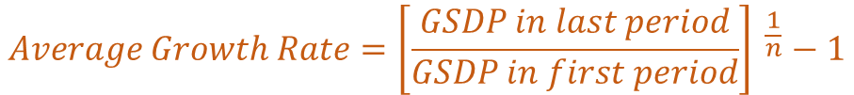
Data Imputation
For each state we compute the average growth rate as follows:
$$Average Growth Rate={\left[\frac{GSDP in last period}{GSDP in first period}\right] }^{\frac{1}{n}}−1$$
Last Period: 2014-2015 and first period = 2011-2012; n is the number of periods and is equal to 4.
The average growth rate is a decimal value. To express it in percentage we need to multiply it by 100.
With this average growth rate, we can compute the GSDP for the period 2015-2016 as follows:
$$GSDP for 2015−16=GSDP for 2014−15+ GSDP for 2014−15 ( Average Growth Rate)$$

Slide 11
Data Imputation
For each state we compute the average growth rate as follows:
$$Average Growth Rate={\left[\frac{GSDP in last period}{GSDP in first period}\right] }^{\frac{1}{n}}−1$$
Last Period: 2014-2015 and first period = 2011-2012; n is the number of periods and is equal to 4.
The average growth rate is a decimal value. To express it in percentage we need to multiply it by 100.
With this average growth rate, we can compute the GSDP for the period 2015-2016 as follows:
$$GSDP for 2015−16=GSDP for 2014−15+ GSDP for 2014−15 ( Average Growth Rate)$$

Slide 12
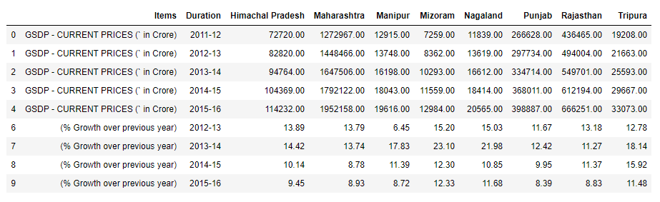
Data Imputation
Missing values (NaN) of 2015-2016 for the following states are imputed with the logic explained in previous slide.

Slide 13
Data Imputation - Computed Values
 | (% Growth over previous year) | GSDP - CURRENT PRICES (` in Crore) | Actuals from Wiki | Prediction Error %
Himachal Pradesh | 9.45 | 114232 | 114239 | -0.01%
Maharashtra | 8.93 | 1952158 | 1966147 | -0.71%
Manipur | 8.72 | 19616 | 19531 | 0.44%
Mizoram | 12.33 | 12984 | 15139 | -14.23%
Nagaland | 11.68 | 20565 | 19524 | 5.33%
Punjab | 8.39 | 398887 | 390087 | 2.26%
Rajasthan | 8.83 | 666251 | 681485 | -2.24%
Tripura | 11.48 | 33073 | 35938 | -7.97%

Slide 14
Split into two datasets
We split the data set into two data frames as follows.
GSDP - CURRENT PRICES (` in Crore) for all states in the years 2011-2012, 2012-2013, 2013-2014, 2014-2015, 2015-2016. 5 rows
(% Growth over previous year) for all states in the years 2012-2013, 2013-2014, 2014-2015, 2015-2016. 4 rows

Slide 15
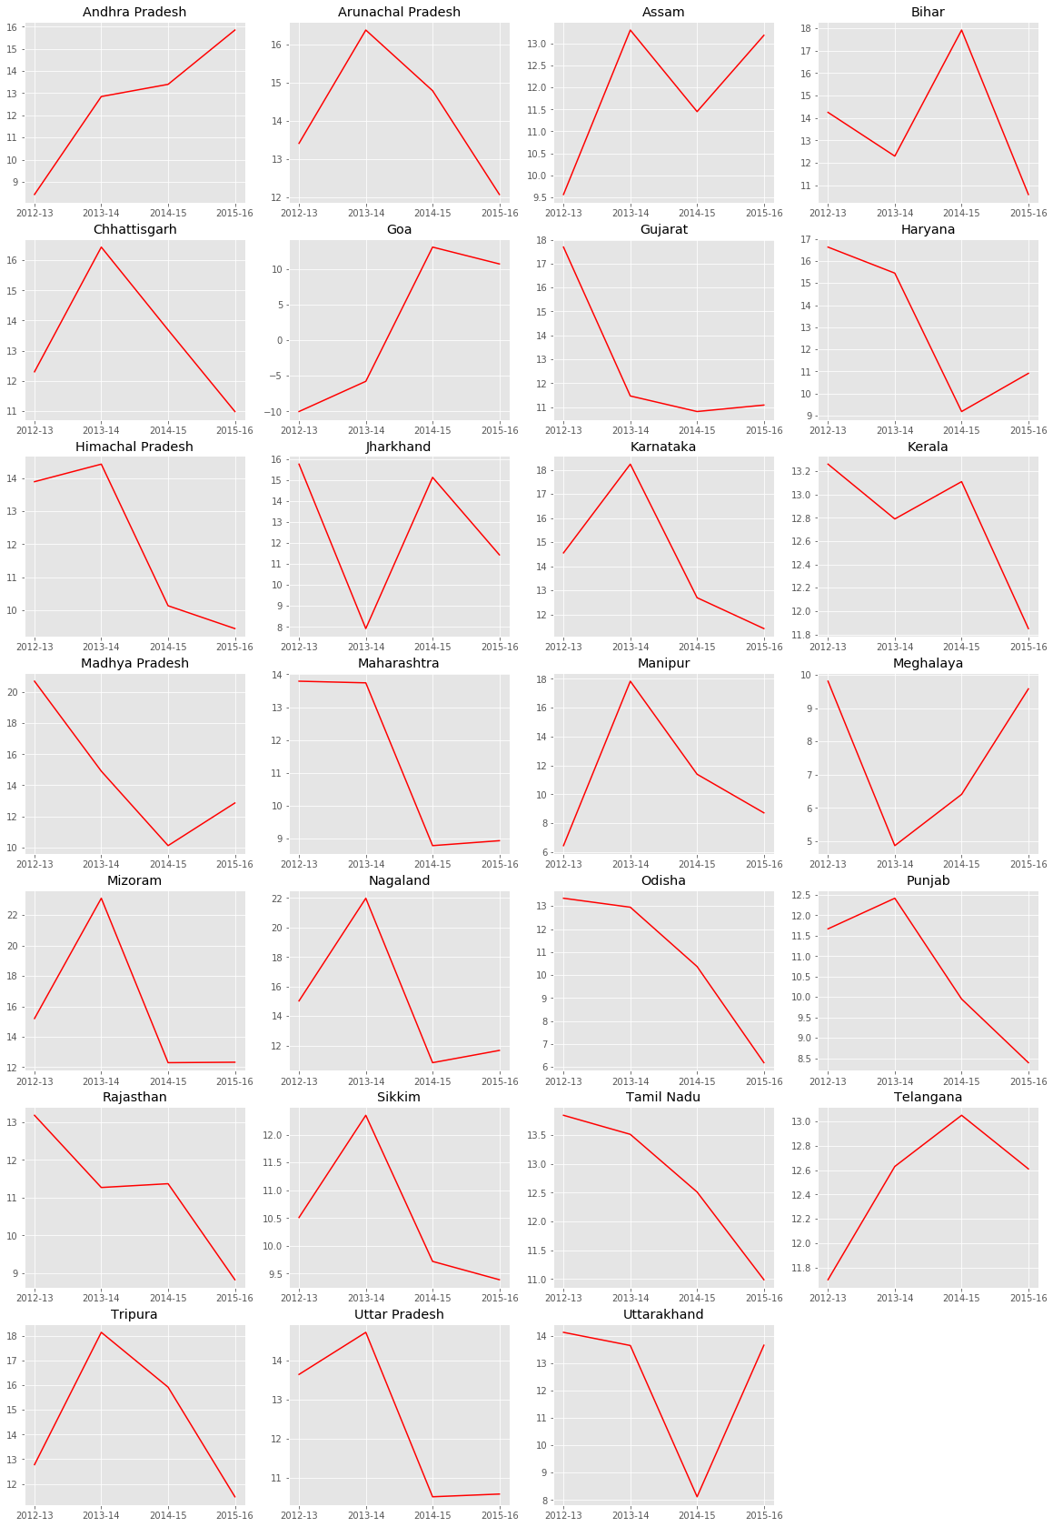
Visualizing Growth Rate
As per the graph, state which has consistent increase in growth rate are Andhra Pradesh. The growth rate is continuously decreasing in Odisha, Tamil Nadu and so on. However this is not enough to conclude on the growth of the State. Hence we need to plot the best fit line to see the trend.

Slide 16
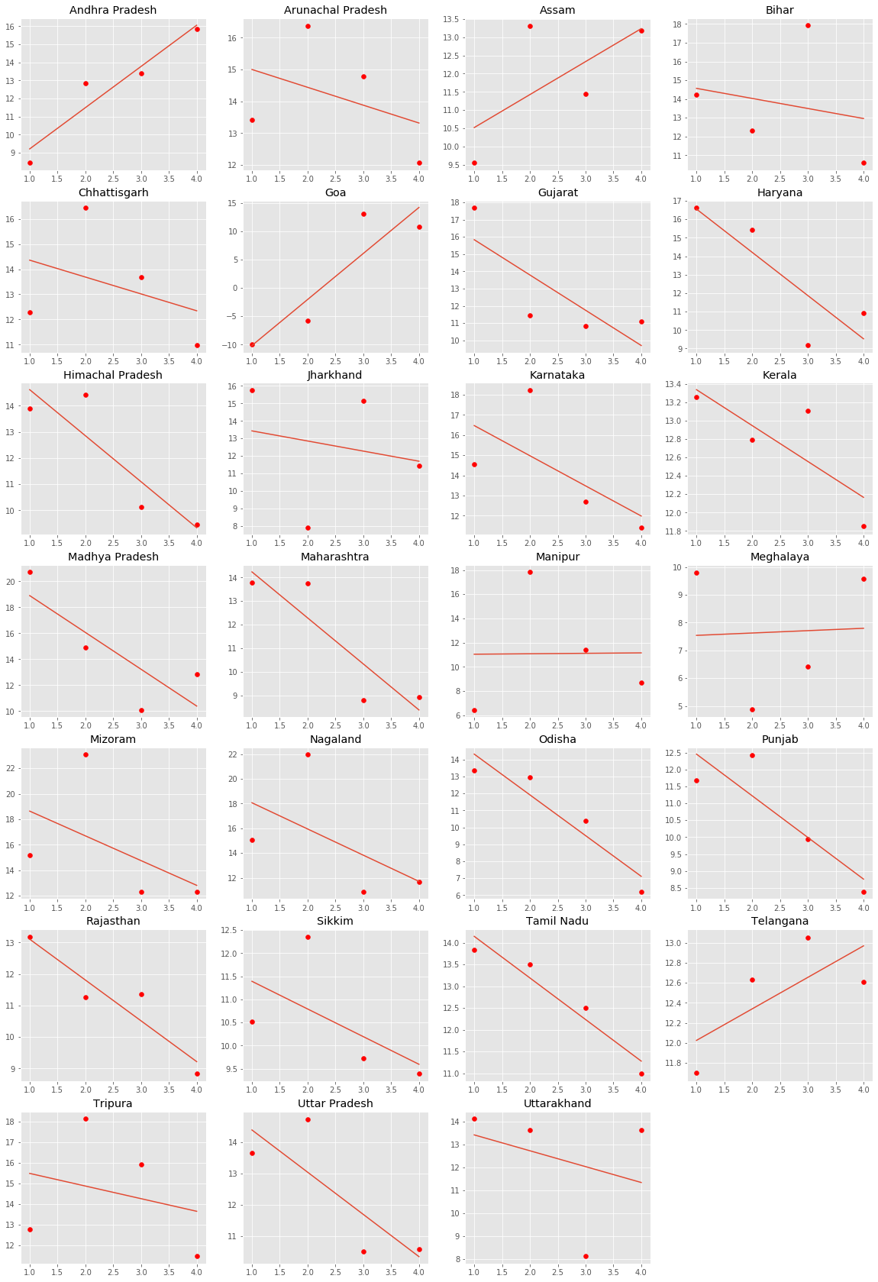
Visualizing Growth Rate
The best fit line shows the actual trend - whether there is increase or decrease. Andhra Pradesh, Assam, Goa and Telangana shows a trend of positive growth.

Slide 17
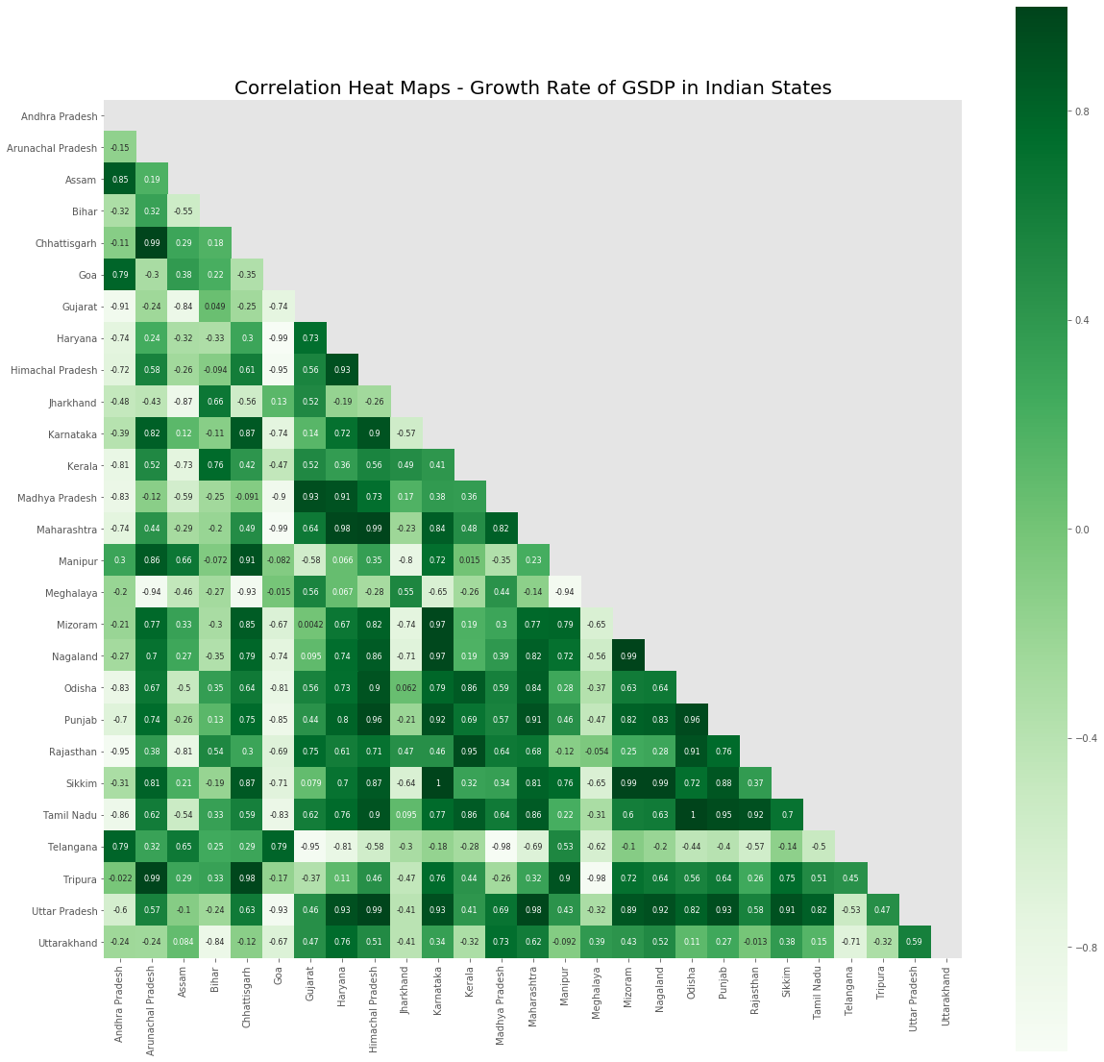
Growth Rates
A positive correlation between the growth rates of the state is indicated with darker green and as it gets lighter the correlation tends to reduce and become negative.

Slide 18
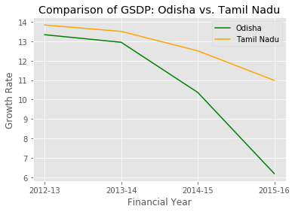
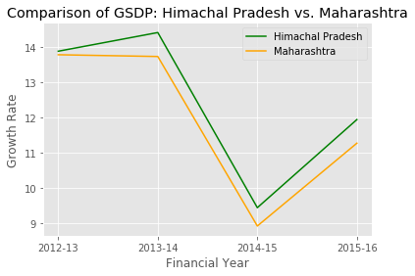
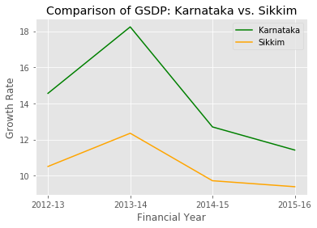
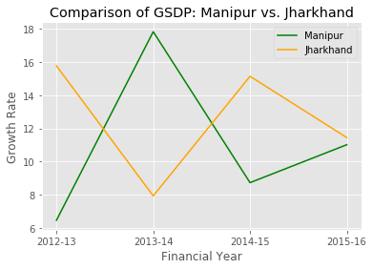
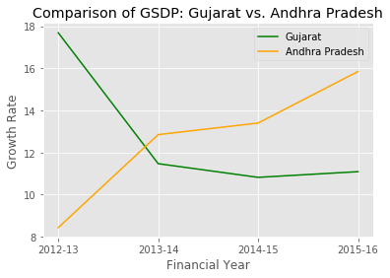
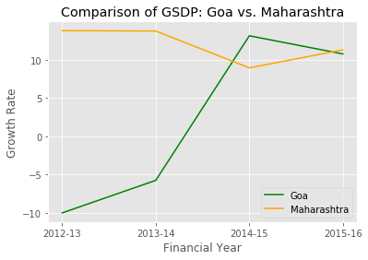
Correlation between States - An Interesting Study
Positive Correlation
Negative Correlation

Slide 19
Studying the Correlation
Code included to study the trend in two different states and see how they are related. It will be interesting to study why these correlation exists? However, correlation does not imply causation. We need to see whether there are any third variable that is causing the correlation.

Slide 20
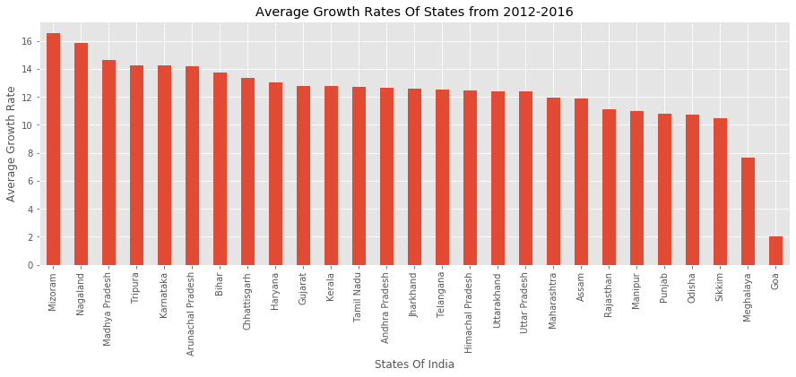
Growth Rate Comparison
Caution: This result may differ from one person to another due to the way the missing values for year 2015-16 are treated. Further this is based on the growth rate, not on the exact value of GDP.
states that are struggling with their growth
states that are growing fast

Slide 21
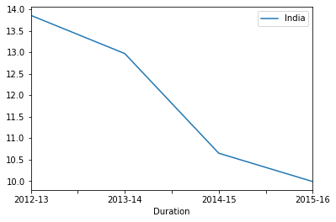
Nation’s Growth Rate
We see that the growth rate is consistently declining across the country. So it is recommended to take up further studies to boost the overall performance of all States to improve the GDP of the country.

Slide 22
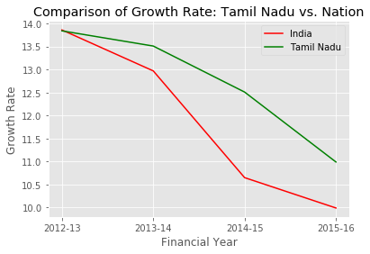
Nation vs. Home State (Tamil Nadu)
As we see in the case of my home state, many states in the country are lagging in growth rate, thus contributing to the overall reduction in growth rate. This is a matter of concern and need to be addressed.

Slide 23
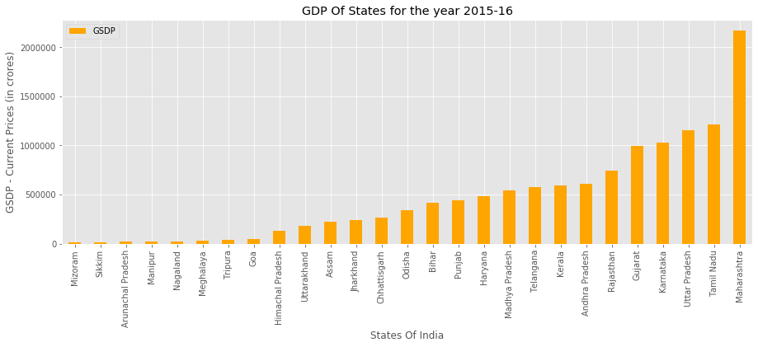
Gross State Domestic Product
We have just seen the trends in the growth rate. To get more insights, we need to study this along with the GSDP.

Slide 24
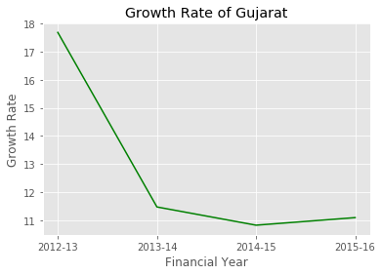
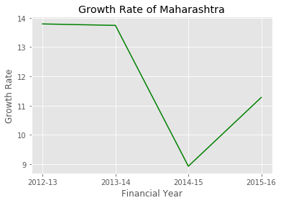
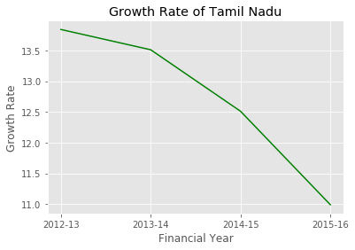
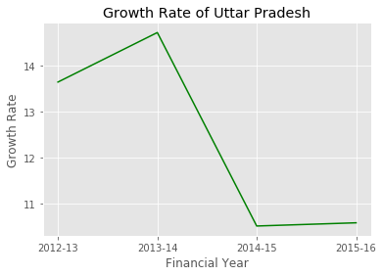
What does the Chart Reveal?
Top 5 states based on GDP :
Maharashtra
Tamil Nadu
Uttar Pradesh
Karnataka
Gujarat
The growth rates of these major contributors is declining.

Slide 25
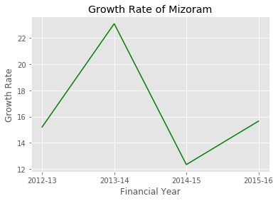
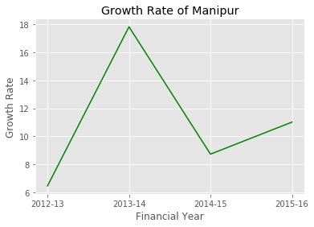
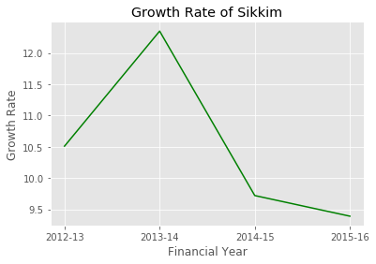
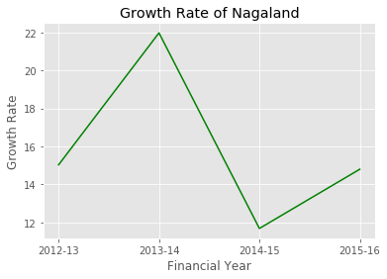
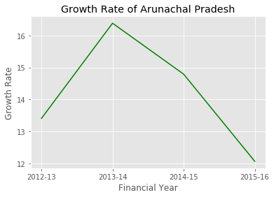
What does the Chart Reveal?
Bottom 5 states based on GDP:
Mizoram
Sikkim
Arunachal Pradesh
Manipur
Nagaland
The growth rates except for Sikkim and Arunachal Pradesh has increased in 2015-16. We have to wait and observe in subsequent years.

Slide 26
A note on the Visualizations used in this section
Heat Map: When dealing with large volumes of data, the colours in heat map are easy to distinguish than the numbers. Thus we get a more generalized view of the numeric values. We used heat map in this assignment to visualize the correlation between the two states.
Line Plots: Suitable for any time series data to study the trend.
Regression Line: Best fit line is used to plot the trend with the help of a number of independent variables. This also helps to predict the future.
Bar Graphs: Can be used to visually compare a measure between different categories. Here we used it to depict the numeric variables GSDP and Growth rate across different states.

Slide 27
GDP Assignment
Part 1 B

Slide 28
Data Sourcing
We studied the GSDP and Growth Rate of the States and the Country. To deep dive into this, we sourced the GDP data for the individual states with contribution from different sectors and sub sectors. Since the Union Territories are governed directly by Central Government, we consider only the data for the different states in the country.

Slide 29
Understanding the Data
The contributions from Primary (Agriculture), Secondary (Industry) and Tertiary (Services) together gives the GSVA. These sectors are further divided into sub sectors.
GSDP = GSVA + Taxes on Products - Subsidies on Products
Per Capita GDP = GSDP / Population of the State
The files contain the data for multiple years for a specific state. But, we will focus on 2014-15 data for our analysis.

Slide 30
Sectors & Sub-sectors
Sectors | Sub Sectors
Primary (Agriculture) | Agriculture, forestry and fishing
 | Mining and quarrying
Secondary (Industry) | Manufacturing
 | Electricity, gas, water supply & other utility services
 | Construction
Tertiary (Services) | Trade, repair, hotels and restaurants
 | Transport, storage, communication & services related to broadcasting
 | Financial services
 | Real estate, ownership of dwelling & professional services
 | Public administration
 | Other services

Slide 31
Data Quality Issues
We have to filter out the Union Territories.
We have to load only the data for 2014-15 for our analysis.
Data from the individual files are consolidated in a single data frame.
In some of the cases the Item field is having trailing spaces or unwanted characters like asterisk (*) or dot (.) which need to be stripped out before further analysis.

Slide 32
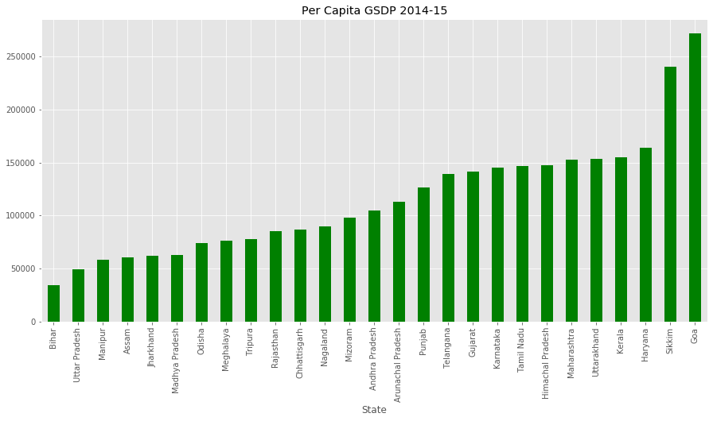
GDP Per Capita for all States (2014-15)
Top 5 states: Goa, Sikkim, Haryana, Kerala, Uttarakhand
Bottom 5 states: Bihar, Uttar Pradesh, Manipur, Assam, Jharkhand
Ratio of highest per capita GDP to the lowest per capita GDP. 8.004741709371503 i.e. Goa is having 8 times more per capita GDP compared to Bihar
We need to filter only rows containing GDP per capita (computed as total GSDP / Population of the state) from our dataset.

Slide 33
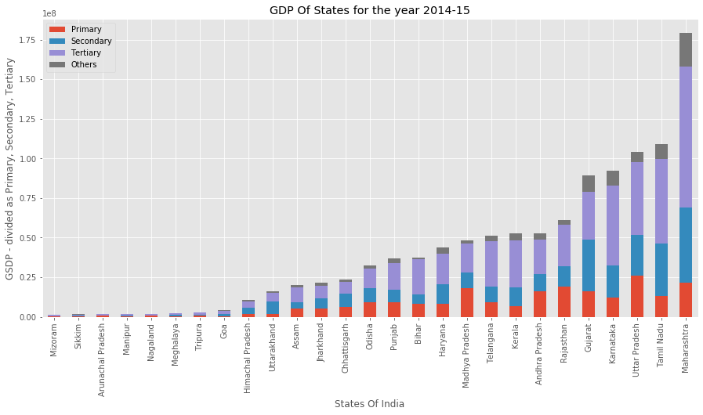
GDP of States in Different Sectors
Adding the GSDP from Primary, Secondary and Tertiary does not give the GDP of the State. GDP = Primary + Secondary + Tertiary + Taxes on Products - Subsidies on Products The difference is indicated in the grey shaded portion of the gap (indicates tax - subsidy)
Visuals depiction of contribution from different sectors to the GSDP of the State using a stacked bar.

Slide 34
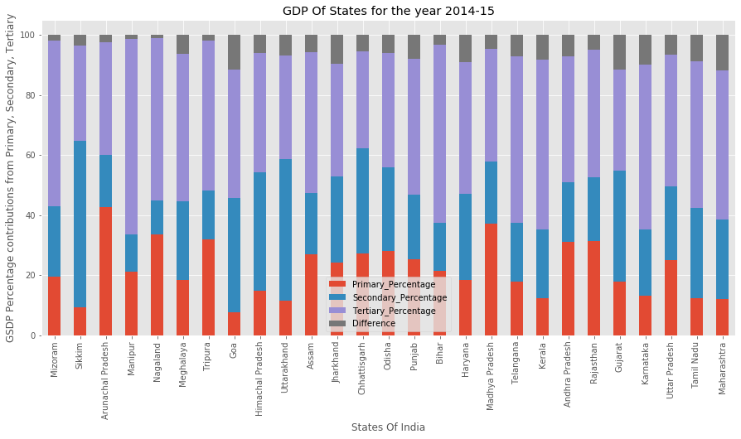
Visuals depiction of % contribution from different sectors to the GSDP of the State using a stacked bar.

Slide 35
Categorizing the States
For further analysis we categorise the states into four groups based on the GDP per capita. This will simplify the subsequent analysis, as otherwise, comparing the data of all the states would become quite exhaustive. We have to prepare the data frame for further analysis on categories and sub-sectors.
 | Quantile | GDP Per Capita
C4 | 0-20 | > 0 and <= 65187
C3 | 20-50 | > 65187 and <= 104977
C2 | 50-85 | > 104978 and <= 153246
C1 | 85-100 | > 153247 and <= 271793

Slide 36
Categorizing the States
C1 | C2 | C3 | C4
Goa Sikkim Haryana Kerala | Uttarakhand Maharashtra Himachal Pradesh Tamil Nadu Karnataka Gujarat Telangana Punjab Arunachal Pradesh | Andhra Pradesh Mizoram Nagaland Chhattisgarh Rajasthan Tripura Meghalaya Odisha | Madhya Pradesh Jharkhand Assam Manipur Uttar Pradesh Bihar

Slide 37
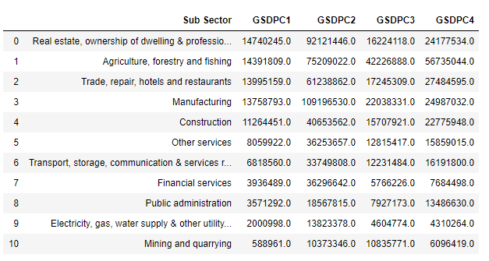
Comparing the GSDP

Slide 38
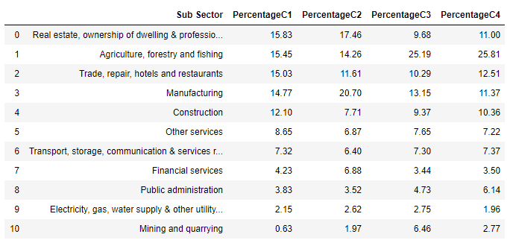
Comparing the GSDP Percentage

Slide 39
Category - Subsector-wise GSDP

Slide 40
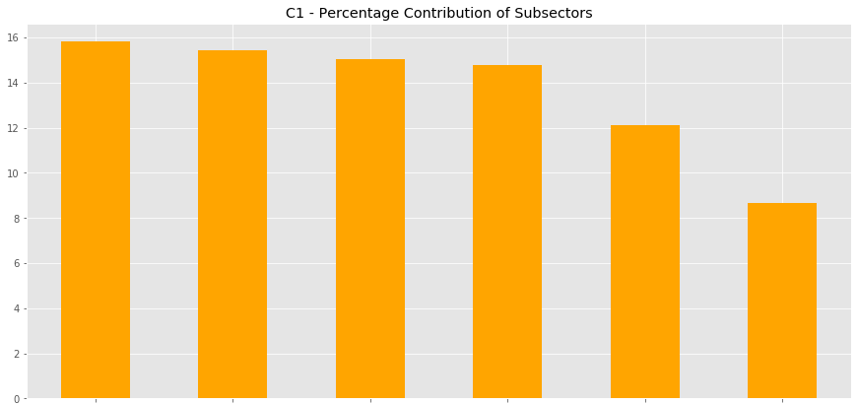
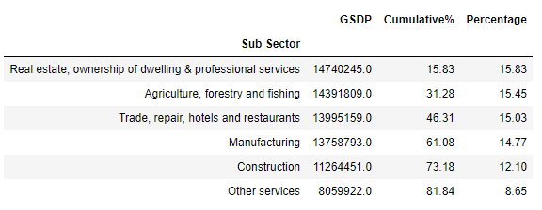
C1
States: Goa, Sikkim, Haryana, Kerala
Observations & Insights
Real estate, ownership of dwelling & professional services
Almost the top 4 sub sectors are contributing somewhat equal percentage. Not dependent on single sub-sector for GSDP.
Agriculture, Forestry and Fishing
Trade, Repairs, Hotels & Restaurants
Manufacturing
Construction
Other Services
Recommendations
Service sector is booming here. Industries are also equally contributing. Mining & Quarrying and Financial services can be focused on to improve the GDP. Public Administration is another area to improve.

Slide 41
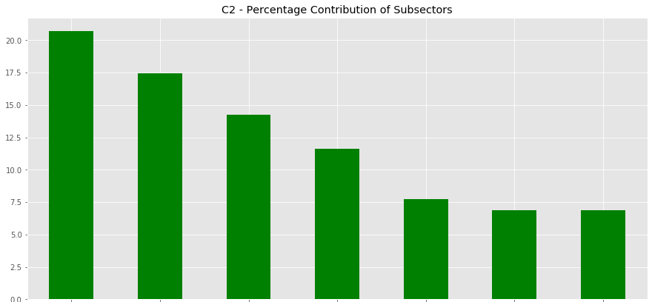
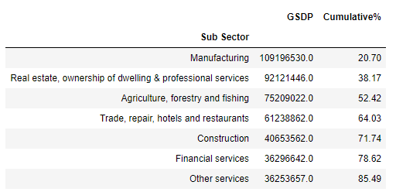
C2
States: Uttarakhand, Maharashtra, Himachal Pradesh, Tamil Nadu, Karnataka, Gujarat, Telangana, Punjab, Arunachal Pradesh
Observations & Insights
Real estate, ownership of dwelling & professional services
Manufacturing is the top contributor in C2. All 3 sectors (primary, secondary, tertiary) are contributing to growth.
Trade, Repairs, Hotels & Restaurants
Agriculture, Forestry and Fishing
Manufacturing
Financial Services
Other Services
Construction
Recommendations
Construction and Other Services can be the focus for further improvement.

Slide 42
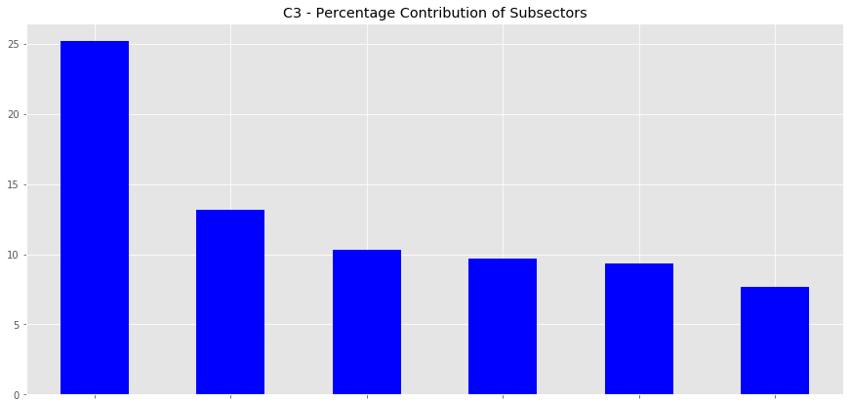
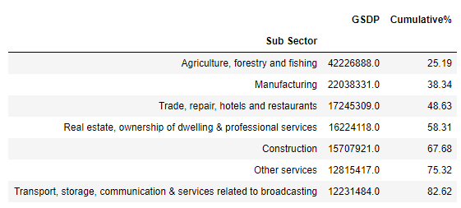
C3
States: Andhra Pradesh, Mizoram, Nagaland, Chhattisgarh, Rajasthan, Tripura, Meghalaya, Odisha
Observations & Insights
Dependency is on Agriculture in C3 states. 25% of GSDP is from Agriculture. Not much growth in industry and services.
Real estate, ownership of dwelling & professional services
Agriculture, Forestry and Fishing
Trade, Repairs, Hotels & Restaurants
Manufacturing
Construction
Other Services
Recommendations
The focus should be on industrial sectors and services. There is also good potential in manufacturing and construction. Real Estate also can grow to improve the GDP.

Slide 43
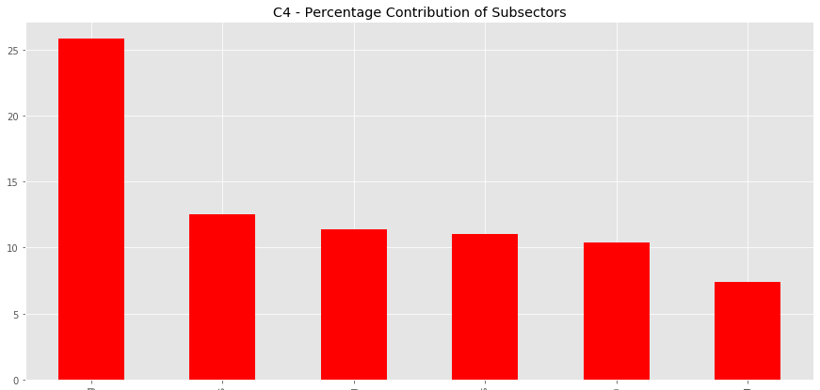
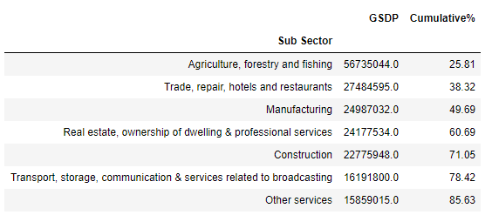
C4
States: Madhya Pradesh, Jharkhand, Assam, Manipur, Uttar Pradesh, Bihar
Observations & Insights
Dependency is on Agriculture in C4 states. 25% of GSDP is from Agriculture. Not much growth in industry and services.
Real estate, ownership of dwelling & professional services
Transport, Storage, Communication, Broadcasting
Agriculture, Forestry and Fishing
Trade, Repairs, Hotels & Restaurants
Manufacturing
Construction
Recommendations
The focus should be on industrial sectors and services. There is also good potential in manufacturing and construction. Real Estate also can grow to improve the GDP. Unlike other categories, Transport is a contribution in top 6.

Slide 44
Other Insights - Top 5 Sub-sectors
These 5 sub-sectors contribute to 65% of the total GDP of the nation.
Agriculture, forestry and fishing (primary)
Manufacturing (secondary)
Construction (secondary)
Real estate, ownership of dwelling & professional services (tertiary)
Trade, repair, hotels and restaurants (tertiary)

Slide 45
Other Insights
In C1 the subsector contributions are balanced very well.
Agriculture is still the primary contributor to GDP of the nation.
States in C3 and C4 contribute through Agriculture.
Manufacturing is the top contributor in C2, and Real Estate in C1.
We can improve GDP by focusing on Services and Industry sectors, but this will require educated and skilled labour.

Slide 46
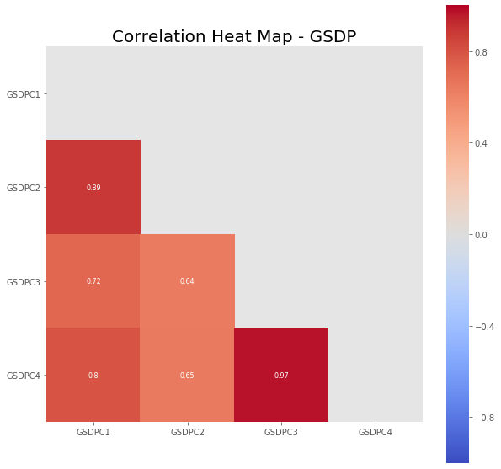
Correlation
GSDP-C3 & GSDP-C4 are strongly correlated.
GSDP-C1 & GSDP-C2 are strongly correlated.
The other correlations are not that strong.

Slide 47
Recommendations
C1: Focus can be on Mining and Financial Services.
C2: Mining and Construction need to be focused upon for growth. Other C2 states are doing well in all the sub sectors.
C3: By focusing on Manufacturing and Real Estate the states in C3 can contribute much more towards the GDP. Financial Services is another potential domain.
C4: Industrial sectors and Services to be focused on, esp. manufacturing and real estate can help growth of these states.
C2, C3, C4 can try to balance their contribution in different sub sectors.

Slide 48
A note on the Visualization
Bar Chart: Can be used to visually compare a measure between different categories. Here we used it to depict the numeric variables GDP Per Capita across different states.
Stacked Bar Chart: Helpful in showing the relative sizes between different categories, especially a stacked percentage bar.

Slide 49
GDP Assignment
Part 2 - GDP and Education Drop Out Rates

Slide 50
Understanding the Dataset
The dataset provides the drop out rate in different states at different levels of education viz. Primary, Upper Primary, Secondary, Senior Secondary. Data is available for 2012-13, 2013-14 and 2014-15.

Slide 51
Data Quality Issues
Spelling mistakes in state names (Chhatisgarh, Uttarakhand)
Created data frame with only the state required for analysis
Many values were null (taken average drop out rate for 2014-15)
Column names: Primary - 2014-2015 and Primary - 2014-2015.1
Column Primary - 2013-2014 is missing. So we assume that Primary - 2014-2015 is the data for Primary - 2013-2014 and Primary - 2014-2015.1 is Primary - 2014-2015.

Slide 52
Data Exploration
We used this data to explore:
Is there any correlation between GSDP and Drop Out Rates
Is there any correlation between Sector-wise contribution and Drop Out Rates
Is there any correlation between population and Drop Out Rates

Slide 53
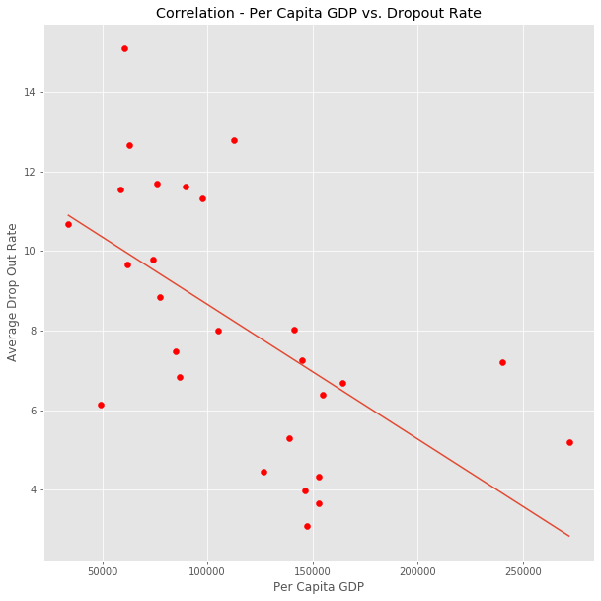
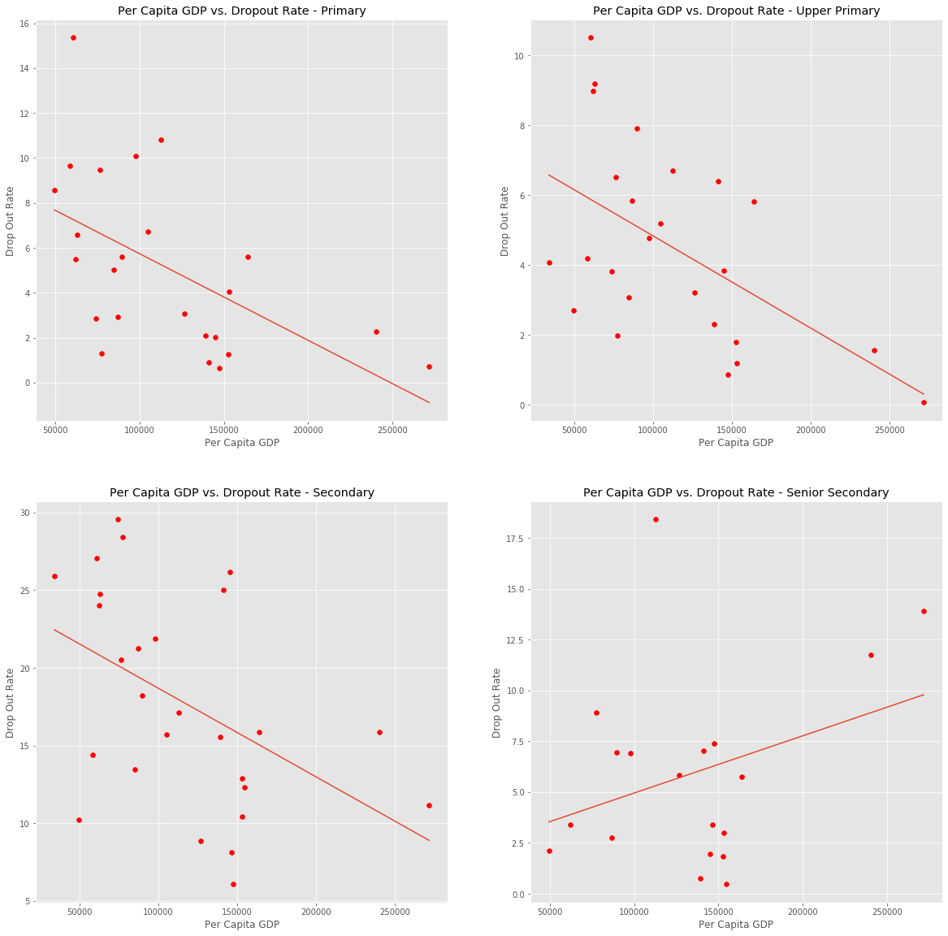
Per Capita GDP vs. Drop Out Rates
Drop out rate reduces if Per capita GDP is high. However, in senior secondary we see a different trend. With increase in GDP, the drop out rate also increases.

Slide 54
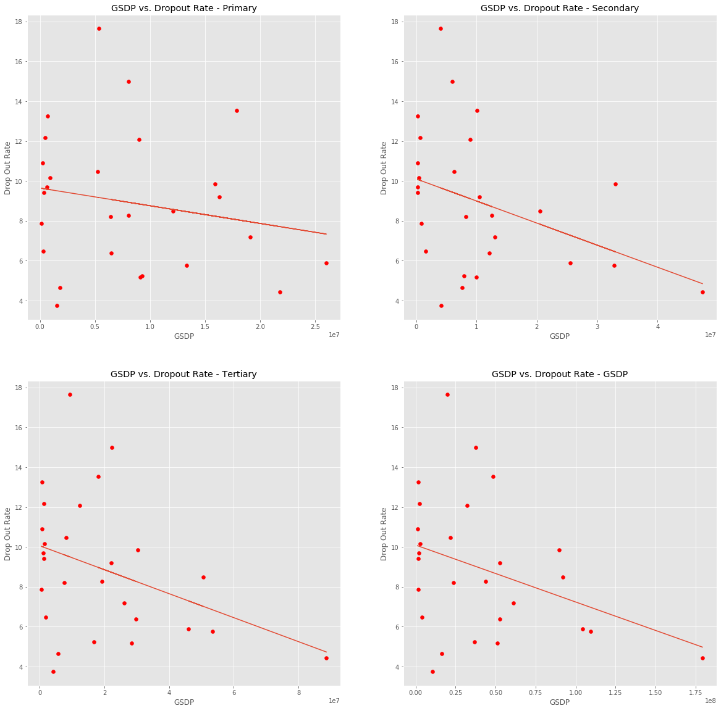
Sector GDP vs. Drop Out Rates
For all sectors if the GDP is high, then drop out rates are less.

Slide 55
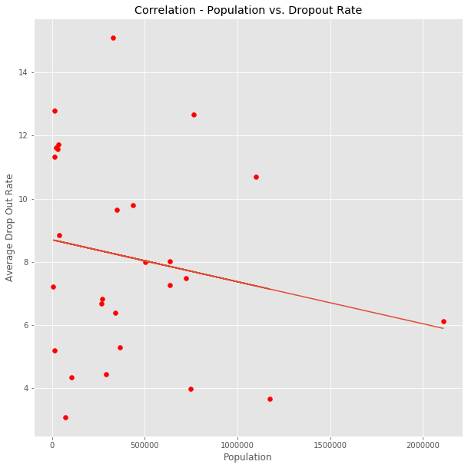
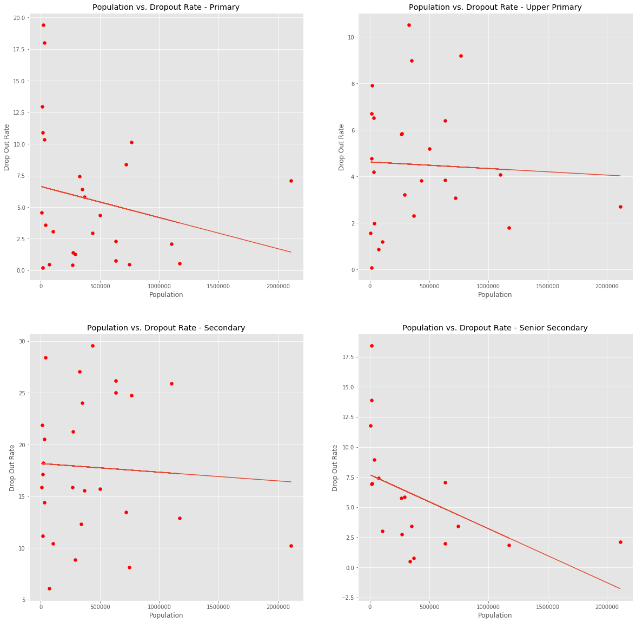
Population vs. Drop-out Rate
The correlation is not very strong. The drop out rates are spread across in the places with low population than in the states with higher population.
Higher the population, lower is the drop out rate.

Slide 56
Hypothesis
In states where the GDP is high, the senior secondary students drop out from educational institutions.

